Slide 1
Week 19

Slide 2
Overview
Structure of a project
Namespaces
Re-useable user controls in WinForms
Dropdown menus in WinForms
Using tabs in WinForms

Slide 3
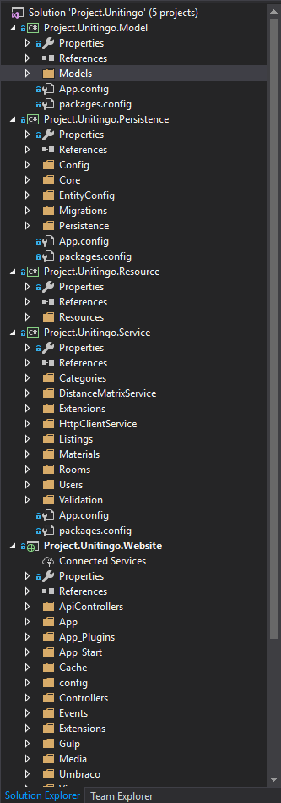
Structure of a project
Solution file
Projects
Folders
Namespaces
Assemblies
DLL

Slide 4
Namespaces
Namespaces help you control the scope of class and methods.
Especially useful when dealing with large projects.
Namesspaces are designed to keep one set of names seperate from another.
The class names declared in one namespace does not conflict with the same class names declared in another.

Slide 5
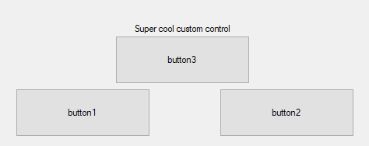
Re-useable user controls
Greatly improves reusability
Is useful for creating simpler WinForms applications
Encapsulate logic inside single components

Slide 6
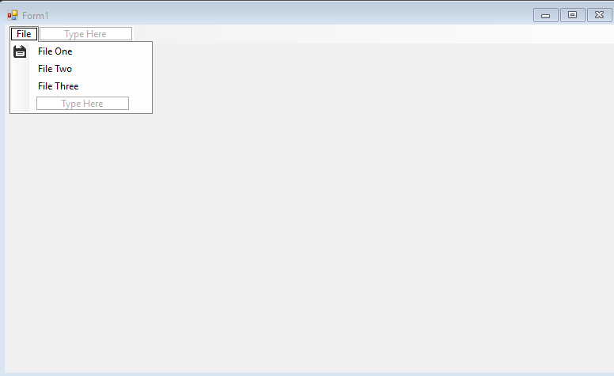
Dropdown menus
Tool strip component
Adding images
Using events on the dropdown buttons

Slide 7
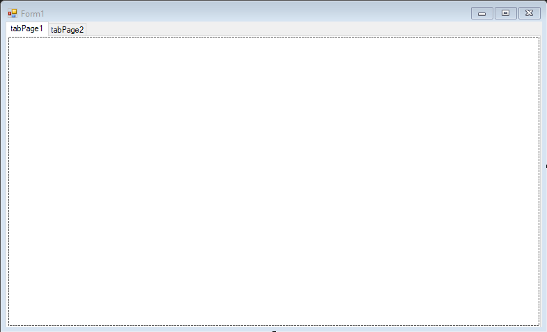
Using tabs
Tab control component
Enables multiple views in the same form, same as tabs seen in a browser.

Slide 8
Exercise UI tools
Try out the new UI tools in a WinForms application
Re-useable controls
Dropdown menu
Tabs
When trying out the new tools, try to think about folder and namespace structure.

Slide 9
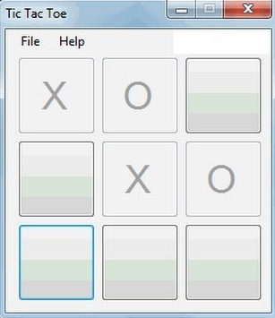
Exercise implement old solutions into GUI applications
Try to take old projects made in a console application and convert them into a WinForms application.
If you don’t feel like doing that, you can also try to finish the calculator from week 15.
Another option is to try and implement the game tic-tac-toe in a WinForms application or mine-sweeper from last week.

